Slide 1
INVENTORY MANAGEMENT SYSTEM IMPROVEMENT FOR DRINK & DELIGHT

Slide 2
TEAM MEMBERS
TEAM 3: TEAM 4:
AKASH ANIRUDDHA
AKHIL ASHWANI
ANKIT DIKSHA
ASHMITA GAURAV
MASHARIB KAUSHIK
PRATHAMESH NAFEES

Slide 3
PRESENT SCENARIO OF DD
Drink & Delight(DD) is India’s first listed pure-play beverage Company and one of the leading fruit juice manufacturers.
DD has beverage brands in over 20 states and have 400,000 retailers, over 2500 distributors and 200 plus super stockist.
The company has seven operational manufacturing facilities:
3 at Vadodara, 2 at Varanasi, 1 in Dehradun and Ambala, 4 at Bangalore and 2 at Chennai.
Since 2015, DD’s revenue has been increasing at a rapid rate of > 26% per year on year.
The total revenue of this year is ₹984.95 crores whereas in the last fiscal year 2016-17 the revenue was ₹735.02 crores.

Slide 4
PRODUCTS
JUICE
SOFT DRINKS
ENERGY DRINKS
MOCKTAILS
TONIC WATER

Slide 5
NEED FOR AN INVENTORY MANAGEMENT SYSTEM
Inventory has to be maintained:
To meet anticipated demand
To smooth production requirement
To protect against stock-out
To take advantage of order cycles
To hedge against price increases or to take advantage of quantity discounts
To permit operations
To decouple components of the production-distribution system
Maintaining the inventory is becoming a tedious job over the years because of the expansion in business. Till date the inventory was maintained in excel sheet. This led to inaccurate information on the orders inventory and is sometimes left with more than needed.

Slide 6
FUNCTIONAL REQUIREMENTS:
Stock Management: ow much to order and when to order.
Operational Cost: Increased operational efficiencies and employee productivity
Manufacturing Management:
Manage Warehouse
Manage Production and Quality
Manage Product Shipping Addresses
Maintain Addresses List
Store Inventory: Reports on a monthly basis on the time an item spent on shelf of inventory. Track the time taken for the items to reach the Retailer

Slide 7
NON-FUNCTIONAL REQUIREMENT:
Performance Requirements:
All canned reports should be published in < 10 seconds
All ad hoc reports should be published in < 5 seconds
Customer Order screen should be able complete submission of customer order within 3 sec including all validations on shipping address.
Customer Address List screen should not take more than 2 sec
Operations and Reliability:
Up time requirement
Acceptable data loss
System update
Disaster Recovery Requirements:
Platform Requirements

Slide 8
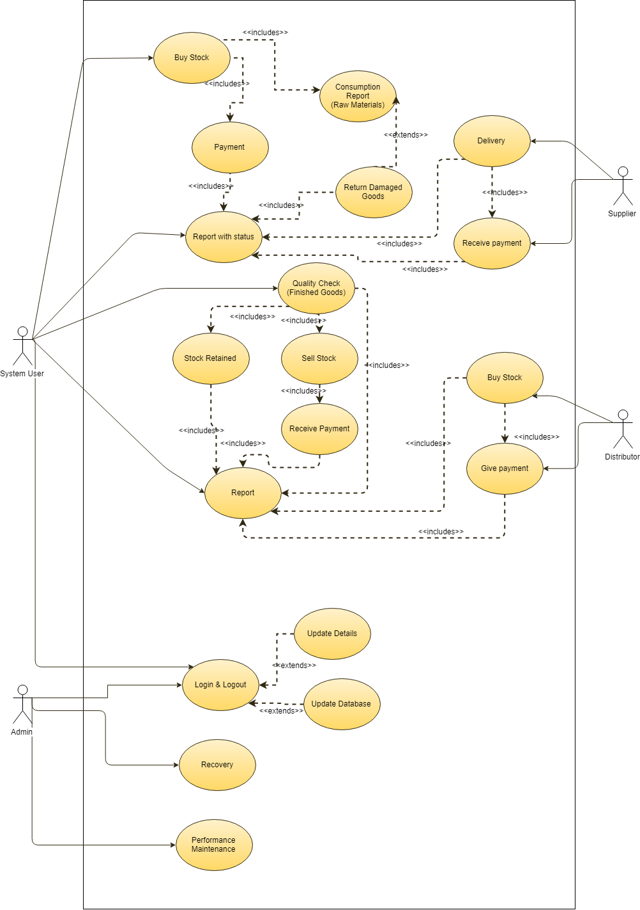
USE CASE DIAGRAM

Slide 9
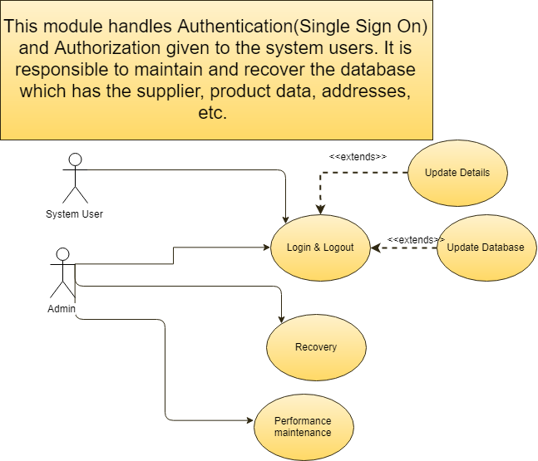
Authentication

Slide 10
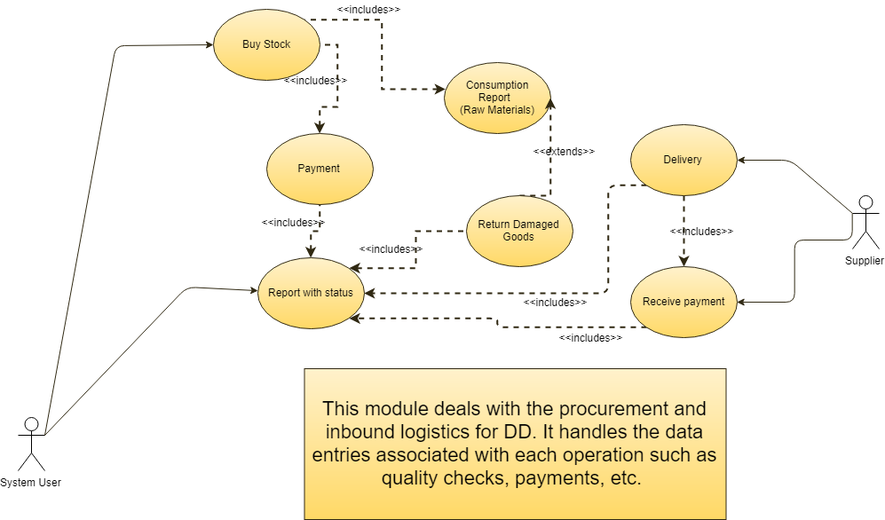
RAW MATERIAL

Slide 11
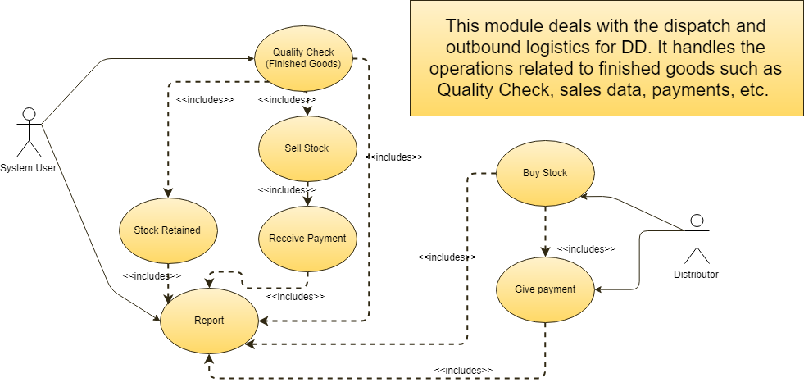
FINISHED GOODS

Slide 12
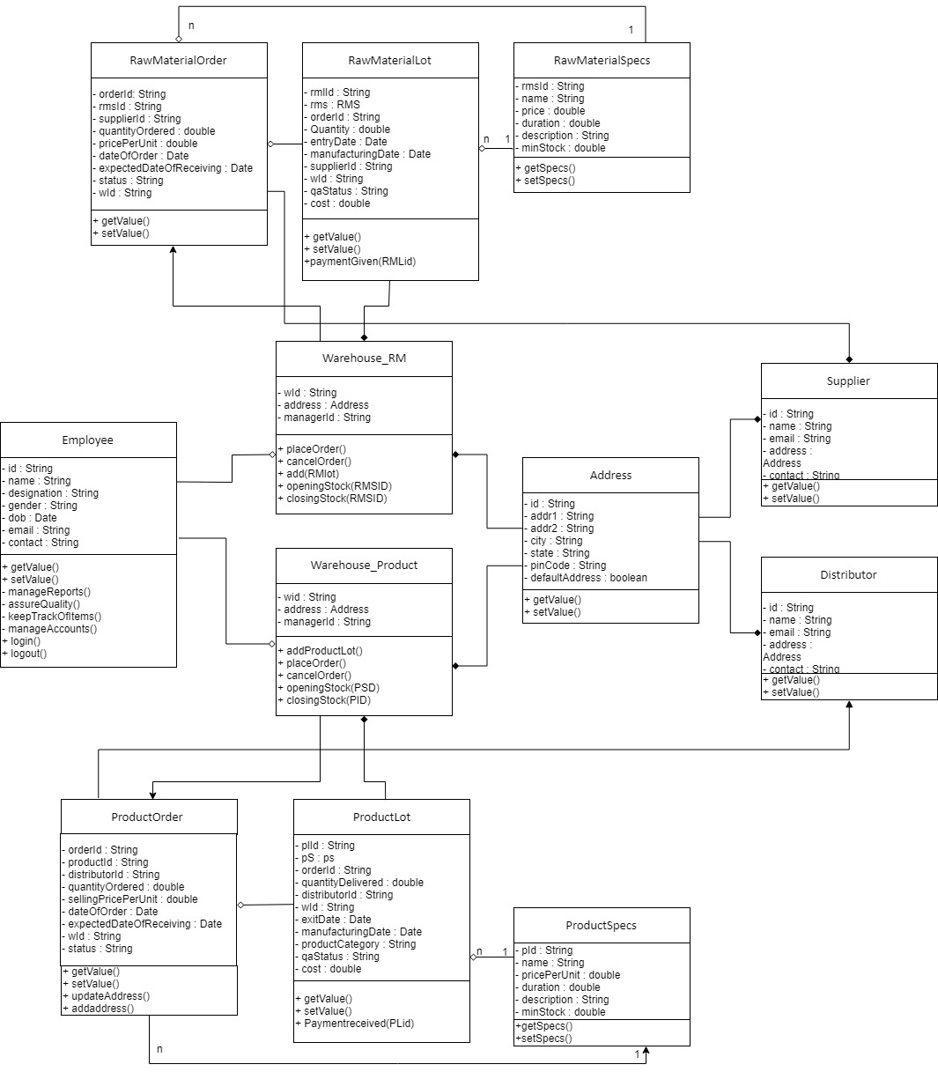

Slide 13
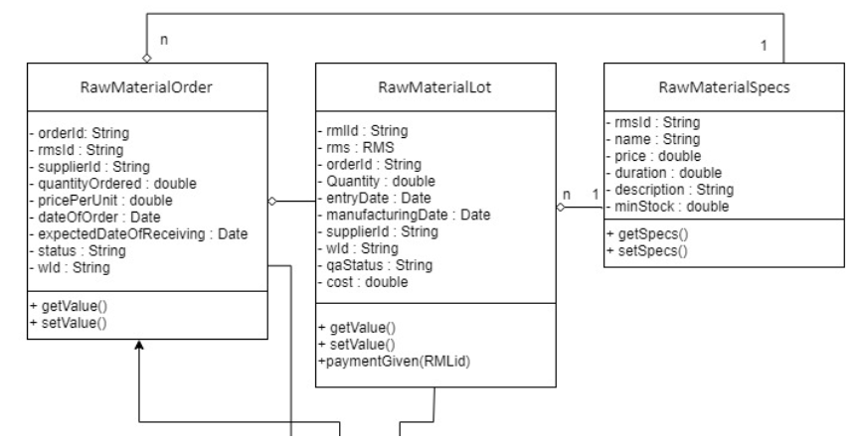

Slide 14
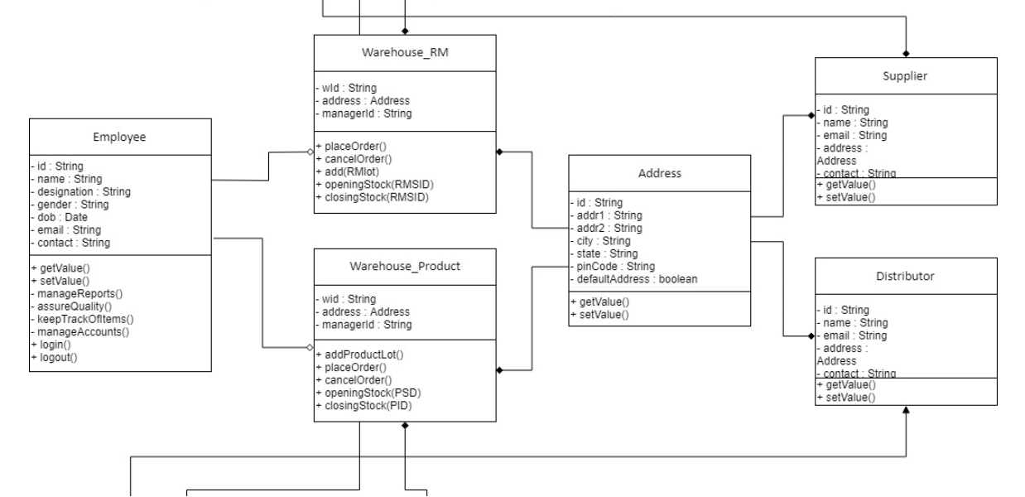

Slide 15
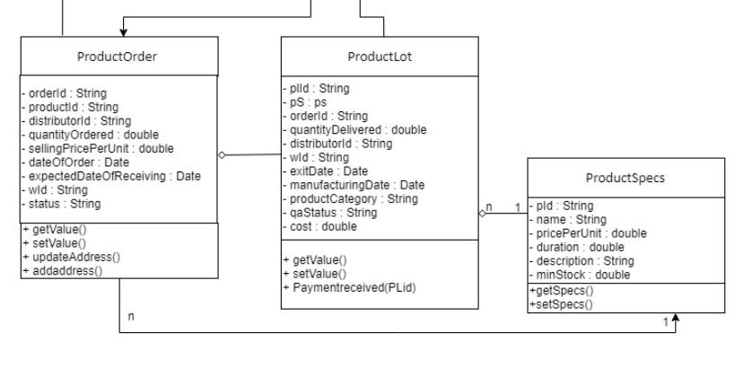

Slide 16
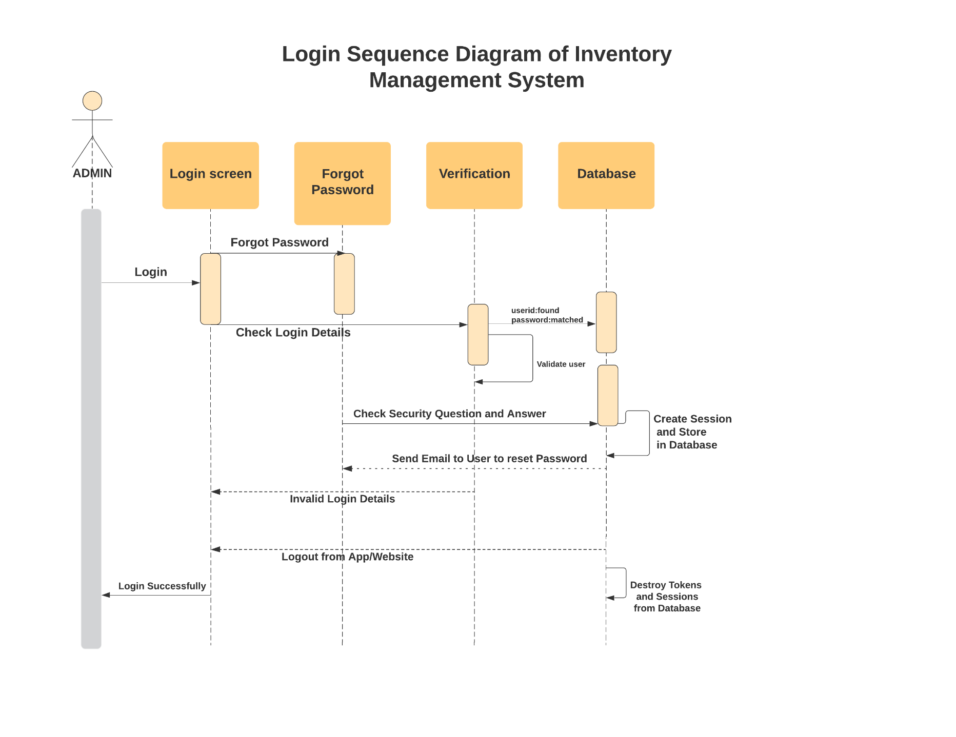

Slide 17
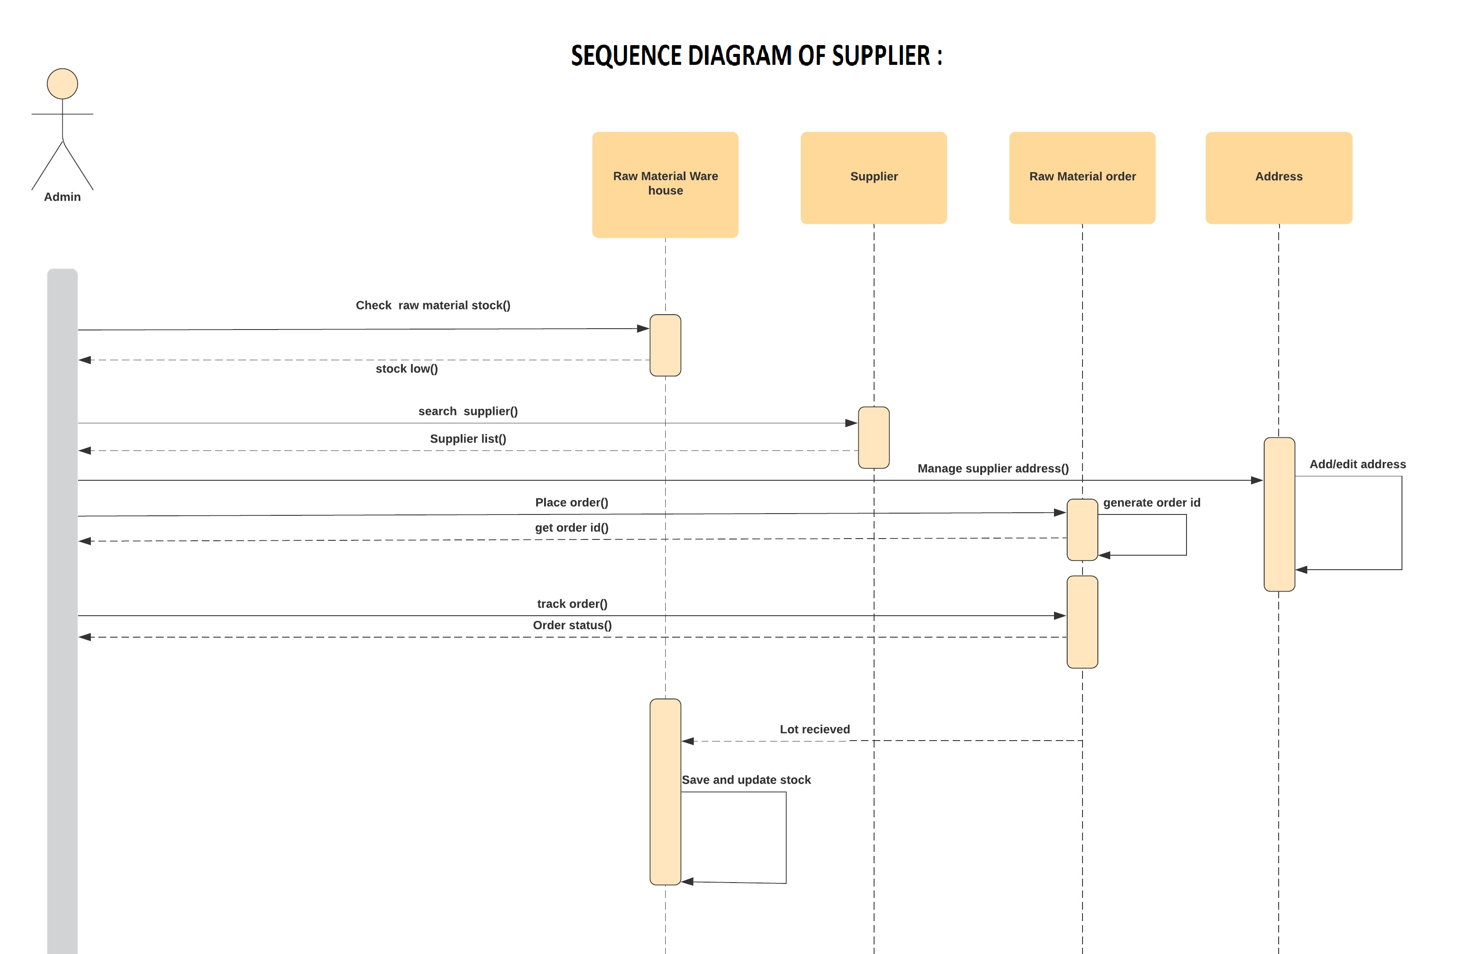

Slide 18
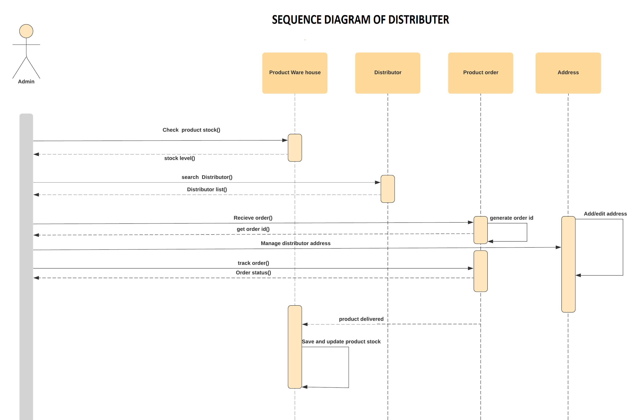

Slide 19


